Slide 1

DEPARTMENT OF CSE Institute of technology
GURUGHASIDASVISHWAVIDYALAYA
ONLINE SHOPPING DESIGNING(MINOR PROJECT)
Guided By :-
Mr.Puspendra Kumar Chandra
Presented By :-
Maddula Sai Sunamdha Harinhi
Dasari Gayathri
Thokala BhagyaLakshmi
B.Tech (5th Semester)

Slide 2

.
ACKNOWLEDGEMENT
We would like to place on record our deep sense of gratitude to :-
(Associate Professor & HOD(I/C))
(Department of CSE ,IT, GGV)
We would also like to express our special gratitude towards our Academic Professors :-
Mr. Pushpendra Kumar Chandra
(Associate Professor)
(Department of CSE ,IT, GGV)
for their stimulating guidance, continuous encouragement and supervision
throughout the course of present work.
We also wish to extend our thanks to all the faculties and our other
classmates for inspiration , encouragement and for their insightful
comments and constructive suggestions.
Mr. Nishant Behar

Slide 3
INTRODUCTION :-
Online shopping is the process where by consumers directly buy goods or services from a seller in real – time without an intermediatory services over the internet
It is form of electronic commerce
An online shop , e-shop , e-store , internet shop , web shop , online store or virtual store evokes the physical analogy of buying products or services at a bricks – and – mortar retailer or in a shopping center
The process is called Bussiness - to consumer (B2C) Online shopping

Slide 4
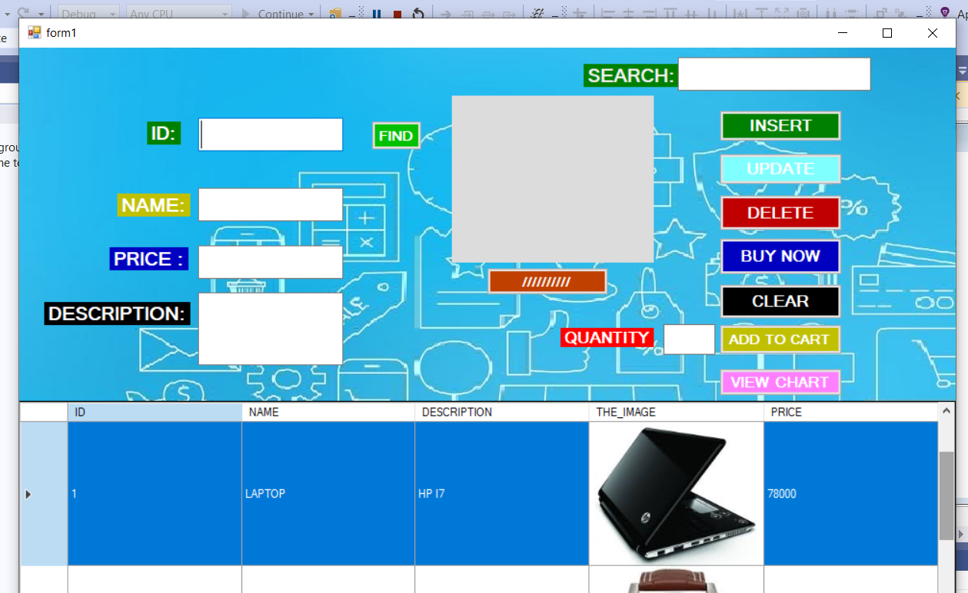
Design of Form 1:-
This is the Homepage of our project
It have
BUTTONS
Add To Cart – is a way to create temporary list of items by adding them to your cart,which will keep items till end of shopping
View Cart – Through which you can view temporaray list
Buy Now – Through which customer buy the selected products
Clear – clear the data
Find – search item through ID
Search – search item through id,name , price , description
TEXT BOXES
ID,NAME,PRICE,DESCRIPTON,QUANTITY.
Show Details of Selected Item

Slide 5
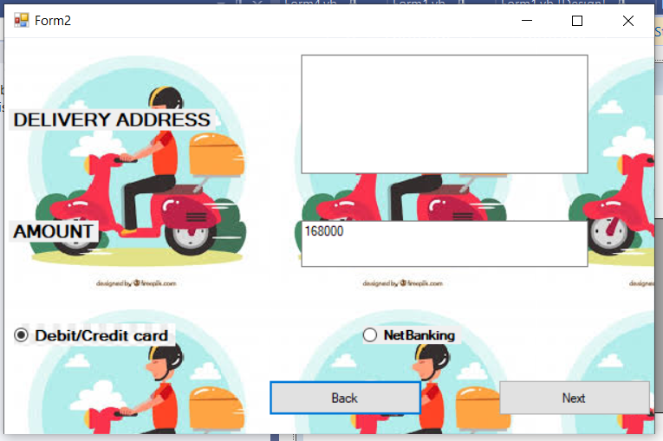
Design of Form 2 :-
In this form the user have to enter the delivery address and user can choose the payment method to buy the products like Debit/card or Net Banking. Amount will be displayed automatically according to items present in cart or single item.
It contains two buttons Back , Next
Back -It will show cart which allows user to
modify items of the temporary list
Next- It will forwards request to payment
page

Slide 6
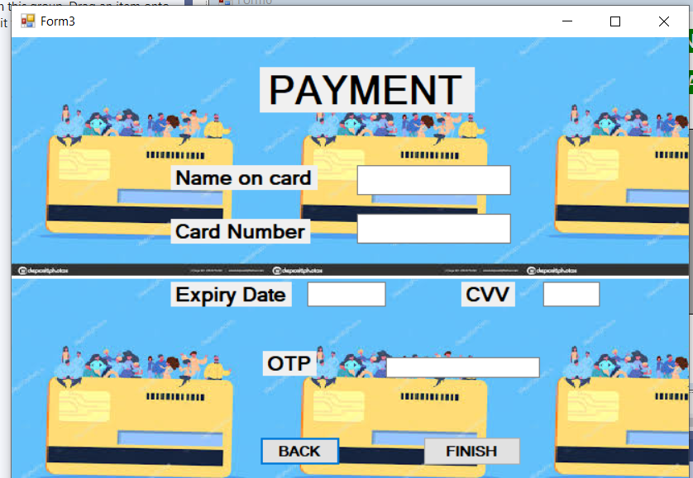
Design of Form 3 :-
This page displays when user choose payment
through Debit/Credit card .In this page user has to enter his card details and OTP generated
It contains two buttons
Finish - If details got entered it will displays
message showing payment done successfully if
Some of the text box left empty then it will display a message asking enter proper details
Back –it will direct your request to form2

Slide 7
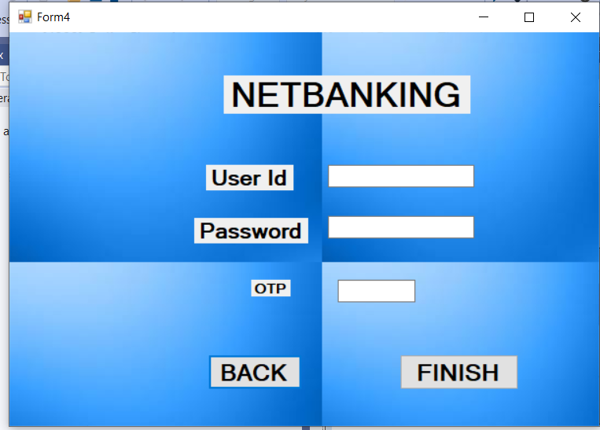
Design of Form 4:-
This page displays when user choose payment
through Net Banking .In this page user has to enter his details and OTP generated
It contains two buttons
Finish - If details got entered it will displays
message showing payment done successfully if
Some of the text box left empty then it will display a message asking enter proper details
Back –it will direct your request to form2

Slide 8
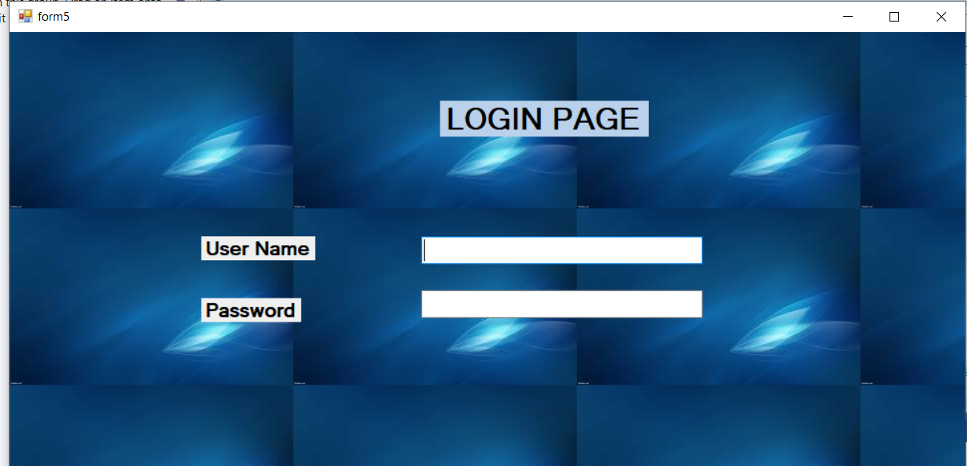
Design of Form 5 :-
Login Page
User has to enter his details like :
User Name
Password
This page contains two buttons
Finish - If details got entered successfully it will forwards request to form2 if
Some of the text box left empty then it will display a message asking enter proper details
Back –it will direct your request to form1

Slide 9
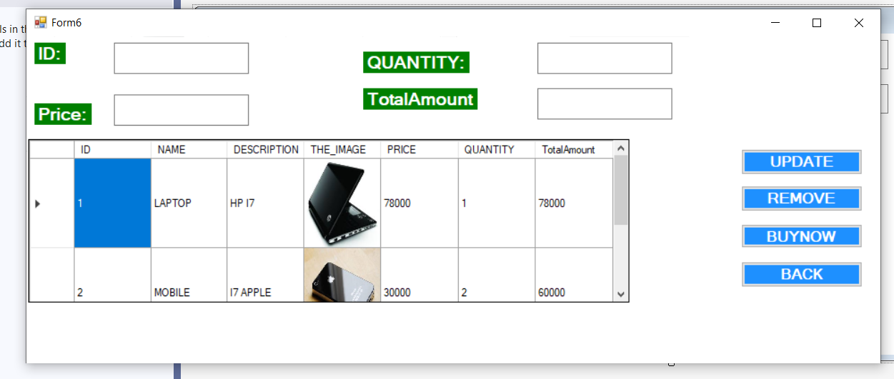
Design of Form 6 :-
This is your cart page it contains four buttons
Update , Remove , Buy Now which helps in
Inserting , updating and removing items from
Temporary list and Back will directs your request to
Home page
It contains four text boxes which displays
ID , Quantity , Price , Total Amount of the selected item

Slide 10
ER Diagrams:-
.
NAME
ID
Table_img
DESCRIPTION
THE_IMAGE
PRICE

Slide 11
ER Diagrams:-
.
TOTAL AMOUNT
NAME
ID
TABLE_VIEWER
DESCRIPTION
THE_IMAGE
PRICE
QUANTITY

Slide 12

Scope :-
Purchasing and selling products and services over the internet without the need of going physically to the market is what online shopping all about. Online shopping is just like a retail store shopping that we do by going to the market, but it is done through the internet. Online shopping has made shopping painless and added more fun. Online stores offer product description, pictures, comparisons, price and much more

Slide 13

Future work :-
As our project doesn’t maintain user details in future we will add More tables to our database such that they can keep track of user Details and details of items purchased by them
We can also add pages where user can enter his reviews
after shopping

Slide 14


